Slide 1
Trendovi i mogućnosti uz digitalnu transformaciju u edukaciji
Oliver Zofič, Acting CEE Education lead & MW specialist

Slide 2
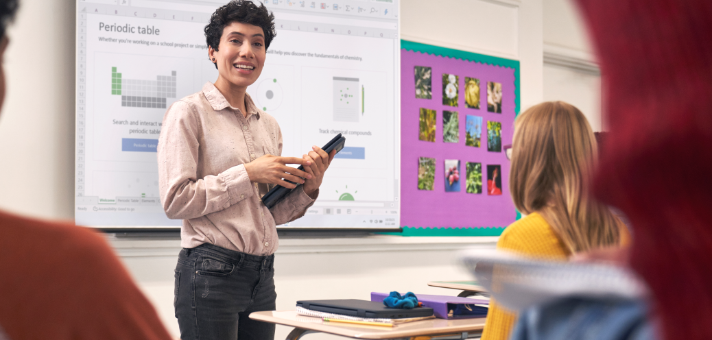
Top Trends Impacting K-12 Education
1. Digital Learning Environments Relate to learning technology ecosystems created to support fully online, hybrid and
physical teaching practices
2. Learning Insights/Analytics By 2025, 80% of all K-12 orgs will be leveraging some type of analytics applications designed specifically to speed insight
3. Ransomware in K-12 Education K-12 Education organizations will remain a prime target for ransomware through 2025
4. Education IT Staff Hiring/Retention Issues By the end of 2024, 80% of K-12 organizations will be forced to increase their use of third-party support
5. Adaptive Learning Dynamically adjusts the way instructional content is
presented to students based on their responses or preferences
K-12 education’s challenges are evolving, but continue to be significant, nonetheless. The focus for K-12 CIOs is turning to leveraging all the digital investments made to date, identifying which remain to be made, and to creating an agile, composable digital learning organization.
Source: Gartner, Published 8 February 2022

Slide 3
To learning continuity
From learning crisis
Notes:
The vision for us is to move to a place where students everywhere, anytime can be constantly learning. To have ownership and agency to learn in a way that is engaging for them at the right time.

Slide 4
TRANSFORMATION IS ABOUT PEOPLE
Notes:
those that have created the most sustained and sustainable change are those that drive it through people and culture. It has never been enough to air-drop technology into schools and expect change to happen. As we move forward to school post-Covid, I believe it is critically important that we recognize the power of culture, the power that people have. We should be thoughtful about how we use technology – what is the learning culture we are trying to create? How do we empower people to drive change – so much of this goes beyond just technology.

Slide 5
Learning loss = earning loss.
10 trillion $
Projected losses in terms of affected children’s future earnings.
Simulating the Potential Impacts of the COVID-19 School Closures on Schooling and Learning Outcomes: A set of Global Estimates
The World Bank

Slide 6
THE POWER OF EDUCATION TO TRANSFORM
1965
SEOUL, SOUTH KOREA
2015
Notes:
South Korea – ranked 11 in PISA rankings….
Ranked by Bloomberg as the most innovative country
in 2015, South Korea is synonymous with technology.
It topped the ranking in the categories of research and
development as well as, unsurprisingly, patent creation.
Underpinning this is physical infrastructure development
steered by the government.

Slide 7
THE ROAD AHEAD
RESPOND
RECOVER
REIMAGINE
Notes:
When we think about the road ahead post-pandemic – there are 3 phases that I believe most schools in most countries around the world will go through:

Slide 8
THE ROAD AHEAD
RESPOND
Safety of students, faculty and staff. Priority to keep essential services and operations running
Safety of students, teachers and staff. Priority to keep essential services and operations running
RESPOND
RECOVER
REIMAGINE
RESPOND
RESPOND
Notes:
Obviously we need to respond. For many of us – until recently we were in this phase. The priority, rightly so, was the safety of students, teachers, and staff.

Slide 9
RESPOND
RECOVER
Build on lessons learned during crisis and transition to post-Covid world
Build on lessons learned during crisis and transition to post-Covid world
RESPOND
RECOVER
REIMAGINE
REIMAGINE
Notes:
But as we look to recover, we’ll need to take the lessons learned during the crisis as we look to transition to a post-covid world.

Slide 10
RECOVER
REIMAGINE
Digital resiliency. Redesign of academics and operations. Future-ready
Digital resiliency. Redesign of academics and operations. Future-ready
RESPOND
RECOVER
RESPOND
RESPOND
REIMAGINE
Notes:
And finally – we have the opportunity to reimagine. To focus on building digital resiliency. To rethink academics, assessment, curriculum design.

Slide 11
COMPUTATIONAL THINKING
CURIOSITY
CAREER LEARNING
COMPUTATIONAL THINKING
CURIOSITY
CAREER LEARNING
COMPUTATIONAL THINKING
CURIOSITY
CAREER LEARNING
CARING
CURATION
CARING
CURATION
CULTURE
CULTURE
CODING
CODING
CARING
CURATION
CULTURE
CODING
CHARACTER
COMMUNICATION
CREATIVITY
CITIZENSHIP
COLLABORATION
CRITICAL THINKING
CHARACTER
COMMUNICATION
CREATIVITY
CITIZENSHIP
COLLABORATION
CRITICAL THINKING
CHARACTER
COMMUNICATION
CREATIVITY
CITIZENSHIP
COLLABORATION
CRITICAL THINKING
RISK TAKING
REFLECTIVENESS
RISK TAKING
REFLECTIVENESS
RISK TAKING
REFLECTIVENESS
RELATIONSHIPS
RELATIONSHIPS
RELATIONSHIPS
MEANINGFUL
MEANINGFUL
MADE FOR EVERYONE
MADE FOR EVERYONE
MOTIVATING
MOTIVATING
Notes:
a future that will bring rigorous demands for skills in Communication and Collaboration, demands for Creativity and Critical thinking, for Computational thinking, Coding and STEM, and demands that we build Community across all that we do.
These events, whether in person or virtual serve such a rich purpose. I want to thank you all for taking the time to be here, to be a part of the movement to transform our schools – I also want to thank all of you that have been responsible for “holding it all together” during these unprecedented times.

Slide 12
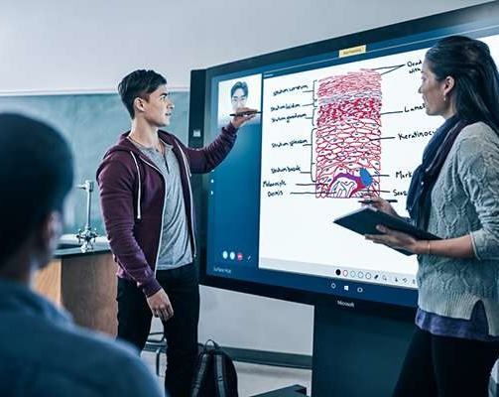
Preparing Students for the Future
Empower Students through Student-Centered Learning
Develop Skills Needed for Students’ Future Success

Slide 13
BUILDING ESSENTIAL LIFE SKILLS
CREATIVITY
COMMUNICATION
COLLABORATION
CRITICAL THINKING
COMPUTATIONAL THINKING

Slide 14
FORMAL
INFORMAL
HIGHLY CURATED
SOCIALLY FILTERED
INDIVIDUAL
COMMUNITY
TEACHING
COACHING
CONSUMPTION
CONTRIBUTION/CO-CREATION
PROCTORED
PEER REVIEWED
GLOBAL SCALE
LOCAL RELEVANCE
MOMENT IN TIME
ALWAYS ON
CENTRALIZED
NETWORKED/FEDERATED
SINGLE-CHANNEL
OMNI-CHANNEL
Notes:
According to some estimates inneffective Training costs US Companies $13.5 Million per year for every 1000 employees. How do we keep it from being ineffective? We must transform how we do learning – in order to realize the benefits that effective learning can bring to an organization.
In other words, the way we learn needs to transform and expand. We are not saying that you replace – these are not arrows indicating a move from one way to another, we suggest it as augmenting what you have today. Making Learning a Growth Engine for your organization – use the six key technology trends to transform the way your customers, partners, and employees learn.
Informal. Redefining what is considered learning. Reading an article or email,
Socially Filtered. Also known as social information filtering or collaborative filtering – “recommendation systems” that identify what might be of interest to a specific sub-set of learners – leading to higher personalization of content.
Contribution/Co-Creation. Learners need to be not passive consumers of content but creating learning artifacts themselves and sharing them back with the community.
Network/Federated. Rather than a push model it needs to be a pull model, where learners take responsibility/interest in their own learning.
Omni-channel. Unifying online, classroom, social, PC/Tablet, phone, etc. Not just using Multi-channel (each of the independently) but unifying them. Delivering the same experience and messages through different channels and devices seamlessly. Want to keep your learners coming back, take a queue from companies that have well-defined omni-channel customer experience management (CEM) – data shows they achieve a 91% higher YoY increase in customer retention rate on average.
We must still deliver at a global scale and now also make learning locally relevant –

Slide 15
THE GROWING DEMAND FOR HIGHER EDUCATION
8B
7B
6B
5B
4B
3B
2B
1B
0
1970
1990
2020
2040
2060
2080
2100
PRIMARY
LOWER SECONDARY
UPPER SECONDARY
POST SECONDARY
Notes:
And that is a big deal because the demand for Higher Education is going to grow, and grow, and grow. According to some outlook models, by the end of this century, there will be more people with a higher education than there are people on the planet today.
When you think about that – you realize that our traditional infrastructure for higher education cannot scale to meet those demands….

Slide 16
Preparing the class of 2030 The future of learning will be student centric: social, personalized and supported by technology.
Preparing students for work and life
Soft skills come into sharp focus
Personalized learning is in high demand
The role of teachers is amplified
Technology creates opportunity
of teachers say time is a barrier to delivering personalized learning
70%
only
42%
51%
30-40%
up to
require soft skills
30%
34%
up to
more classroom time
as few as
Only 42% of employers believe new graduates are adequately prepared for the workforce
30-40% of jobs in growth industries will require soft skills
50% of students put them among their top priorities
Personalized learning can help 70% of students achieve more
70% of students say the current pace isn’t right
Up to 51% teachers report strong relationships with their students…
but only 34% of students agreed
Teachers get up to 30% of time back, gain insights into individual learning, and can amplify the abilities of all students.
http://aka.ms/classof2030

Slide 17
Microsoft has a clear technology roadmap for Education Policy Makers
Leadership & Policy
Teaching & Learning
Vision for Change
Community Engagement & Partnerships
Student-centered Learning
Learning Spaces
Strategic Planning & Change Mgmt.
Continuous Improvement & Culture
Curriculum & Assessment
Devices for Learning
Intelligent Environments
Student & School Success
Advanced Analytics & AI
Educator, Leader & IT Development
Equity, Inclusion & Accessibility
Hybrid Learning
Safety, Security & Privacy
Optimized & Sustainable Operations
Future-Ready Skills
Social Emotional Learning
Notes:
For each of these 16 components, Microsoft can help Education Institutions design their approach and implement solutions based on their education priorities and ensure that technology is used in the most effective ways to drive deep and impactful transformation towards a resilient system able to deliver remote and hybrid learning for every student.

Slide 18
Microsoft Education Transformation Framework
Leadership & Policy
Collaboratively envisioning and creating an intentional culture of innovation and learning, with shared goals that engage the community and motivate leaders, educators, and all stakeholders to plan and lead change.
Teaching & Learning
Helping all students achieve their potential by taking a student-centered approach to explore all aspects of teaching and learning: curriculum, assessment, devices, and spaces with a focus on understanding and meeting the needs of all students.
Intelligent Environments
Developing safe and secure onsite and online environments and leveraging data analytics to optimize student outcomes and to create efficient, responsive, and sustainable processes and allocation of resources.
Student & School Success
Anchored in equity and inclusion, building capacity through professional learning and development for all to ensure students develop their social and emotional skills and are successfully prepared for the future.
Notes:
The Microsoft Education Transformation Framework is a guide for education leaders to navigate the complexity of transformation impacting every aspect of their mission. It facilitates the process of envisioning what's possible and developing a strategy to achieve it.

Slide 19
Our support for education systems in the post Covid-19 world
Leverage technology investments to save money and improve outcomes
Equality of access to technology and connectivity to reduce digital divide
Skilling educators and students with tech skills to succeed in work and life
Low cost devices appropriate for every school and student
Harness data created in new remote/hybrid paradigm
Hybrid & Online learning due to Covid-19
Security and Privacy
- Remove data sovereignty barriers

Slide 20
Through the close and ongoing partnership between Microsoft and the education community, we are convinced we can create the right approach to ensure learning never stops. These 6 focus areas are key to consider while navigating the next phases Covid-19 response.
Single, secure identity to unlock potential and access all systems and services
To protect sensitive data wherever it lives or travels.
To safeguard privacy of all students
Infrastructure to empower teaching and learning via connected learning communities
Identity & Credentials
Privacy & Security
Microsoft 365 & Teams
Closing digital gap for Teachers and Students and assuring 100%
Devices for education
Data & Artificial Intelligence
Skills & Employability
Enables teachers to support learners. Helps parents to understand their child's learning progress.
Enabling students, teachers and school leader’s with skills development on demand

Slide 21
ETF Technology
D365 Finance & Operations
D365 Customer Service
Teams for Education
SharePoint
Class Notebook
Chatbots
Outlook
PowerPoint
Data Warehouse
Power BI
D365 Talent Management
PowerApps
Exchange
Forms
Word
Sway
Excel
OneDrive
Azure Data Lake
Augmented Machine Learning
School Administration
Teaching, Learning, Collaboration & Productivity
Data & Intelligence
Azure Active Directory
Azure SQL
School Data Sync
Multi-Factor Authentication
Information Protection
Intune
Network Security
Azure Data Factory
API Management
Flow
Logic Apps
Identity
Security
Integration

Slide 22
Office 365
Adobe
Blackboard Moodle
Minecraft G Suite
School specific
software
Office 365
Power BI
OneDrive
Azure
Student Management System
Teachers and admin
staff can easily manage
classes and rosters.
Learning Software
Students and staff have a
choice of world-class learning
tools and technologies.
Collaboration Tools
Students and staff can collaborate
using email, text, online, chat
and video, as appropriate.
Powerful Insights
School leaders and teachers
can make accurate, informed
decisions with the help of real time analytics and reporting.
Data back up and storage
Student data and school
resources are protected with
secure, scalable online storage
Microsoft Intune
Microsoft Hello / FIDO 2
Automated device management
Modern device management and deployment means updates, and device management are simpler
than ever. A simple, central dashboard controls everything.
Secure
identity management
Support for biometric and dual factor security
Every staff member and student has their own secure identity to safeguard their privacy.
Microsoft
School
Platform
Student Centred
Learning Approaches

Slide 23
Microsoft
School
Platform
Student Centred
Learning Approaches
School oversight
See patterns, issues and opportunities quickly and easily.
Integrated analytics enable you to benchmark performance, attendance and wellbeing across your school.
Student analytics
Students can track their own
performance securely, ensuring they can focus on the areas that matter most.
Teacher analytics
Teachers can monitor their class
performance and wellbeing and quickly
adjust programs to optimise results.

Slide 24
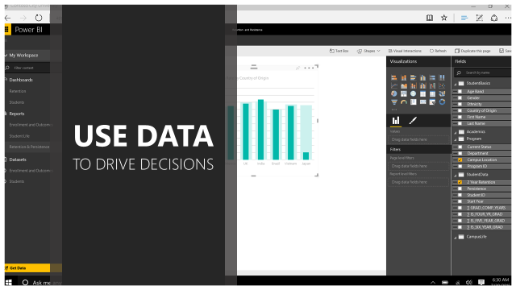

Slide 25
Najlepša Hvala!

