Slide 1
Positionality in postdigital research: the power to effect change
Sarah Hayes
Professor of Higher Education Policy
s.hayes@aston.ac.uk
Notes:
.

Slide 2
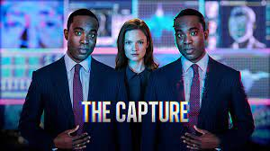
A dilemma - for discussion a bit later
Conducting ‘postdigital research’ opens up an endless range of diverse topics and possible methodological approaches….
Is this a strength? Or a possible barrier to social and political change?
For example
I could explore the controversial topic of ‘digital capture’ through a postdigital lens
Conduct surveys or interviews, or develop a new form of data analysis
But what changes if I ‘capture’ my postdigital method as the way in which digital capture should be researched?

Slide 3
Postdigital research
As a messy, universal concept, postdigital remains widely open to diverse, cultural interpretations of what to research, and how to research it
An inclusive space for ‘postdigital dialogue’ (Jandrić, et. al, 2019) when:
digital technology is an integral part of many people’s (but not everyone’s…) everyday practices
postdigital research addresses an assumption that ‘progress’ is driven by digital technology - that humans, society, diverse cultures, education, economy, etc. must simply adapt
postdigital research examines the ‘entanglement’ of the digital with past, present and future - inviting critical analysis of interwoven elements that may advantage some, disadvantage others
To effect meaningful change, this collaborative community requires concrete examples of studies that reflect our diverse, postdigital positionalities (Hayes, 2021)

Slide 4
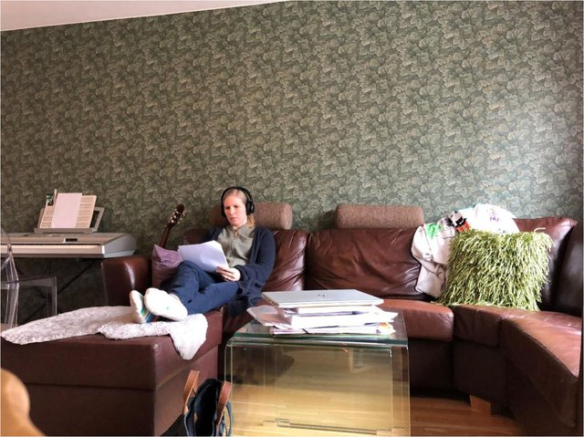
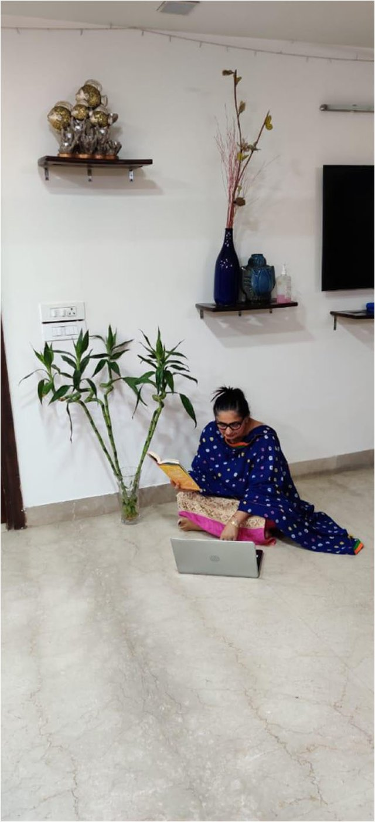
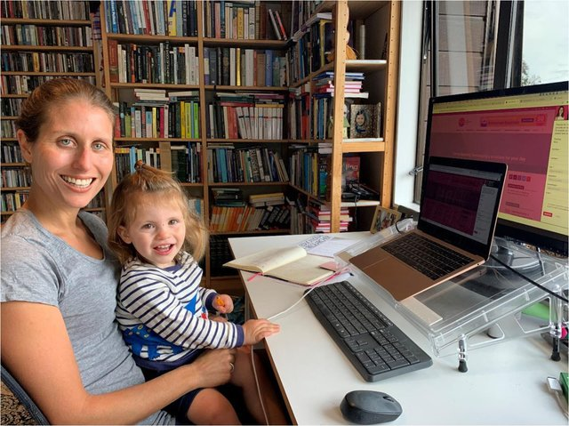
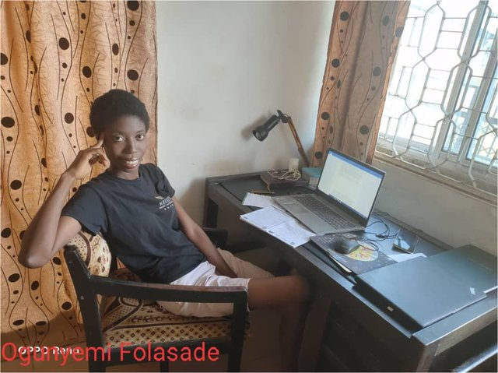
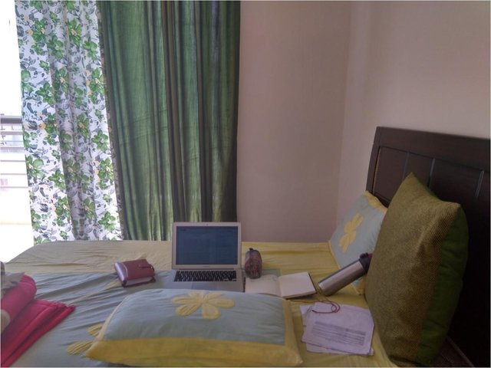
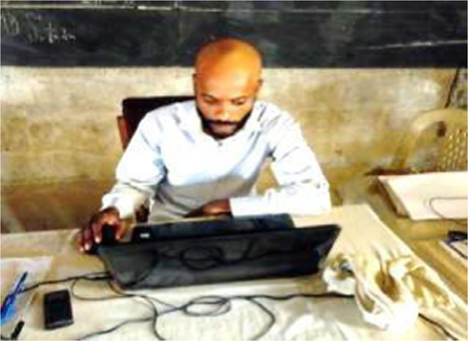
…the Covid-19 pandemic revealed many examples of people’s diverse postdigital positionalities
In this longitudinal research, postdigital testimonies from students, researchers and teachers around the globe were gathered and analysed (Jandrić et., al, 2020, 2021, 2022)
This was one way to explore people’s postdigital positionalities both textually and visually
Jandrić, P., Bozkurt, A., McKee, M., Hayes, S. (2021). Teaching in the Age of Covid-19 - A Longitudinal Study. Postdigital Science and Education. https://doi.org/10.1007/s42438-021-00252-6.

Slide 5
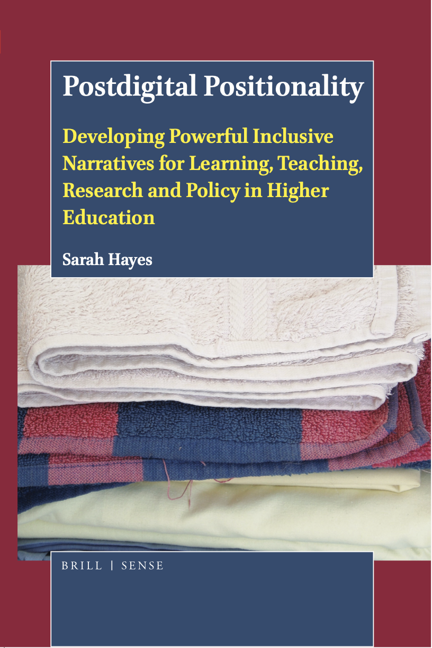
Postdigital positionality
My 2021 book, written during the pandemic, explored new debates on positionality in our postdigital contexts
Asked who/what is able to access, or contribute to what? e.g. digital poverty, systems, viruses, data, IoT, health apps, metrics, surveillance tools, algorithms, bioinformation…) now intersect with former notions of human ‘identity’ (race, gender, status…)
Considered new forms of bias that exclude people, reduce personal agency in unseen ways, across different cultures
Yet, policies for inclusivity in education still sit separately from policies concerning technology and data…

Slide 6
Positionality in postdigital research
Postdigital positionality: a critically reflexive stance by each of us to engage with our own identity, values and potential bias as we conduct postdigital research within a neoliberal, data-driven, digitally unequal society, where wars and culture wars rage
Seeking to understand the positionalities/contexts of those we research
Questions of ‘digital poverty’ often address mainly access to devices and wifi
Questions of ‘postdigital poverty’ ask what else intersects with digital poverty for people?
In Decolonising EdTech Traxler asks how might ‘students from Chinese, Roma, Welsh, Punjabi, Russian, Urdu, Kikuyu, or Cree cultures feel disadvantaged using standard western educational technologies?’ (Traxler, 2022)
Research methods often arrive from a mainly Westernised approach, and funding model
Postdigital research methods draw on a heritage (Jandrić, MacKenzie & Knox, 2022)
Including an emergence from the arts, humanities and creative subjects - currently under attack (Hall, 2022)

Slide 7
Do we need a postdigital research manifesto…. if only to burn it? - Returning to the dilemma
As fast as we develop postdigital research methods, how to avoid traditions of locking these down as the only acceptable way?
What do postdigital ethics look like?
What are the features of a positional, postdigital research stance?
Pledging as a researcher to continually interrogate what is assumed about digital life, positionality and the humanities?

Slide 8
A paradox for discussion: How do we develop stringent research methods, but ensure the power of the messy, open and inclusive idea of postdigital is preserved?
How to capture what it means to ‘think with postdigital noise’ (Macgilchrist, 2021: 663)
Resist rivalry amongst researchers in favour of community
Challenge funding or publishing models
Resist data-driven inequities
Bring diverse global perspectives and positionalities into postdigital dialogue, for meaningful change
Thanks for listening – all comments, questions - and solutions welcomed ☺

Slide 9
References
Hall, G. (2022). Defund culture. Radical Philosophy, 2(12), 62-68.
Hayes, S. (2021). Postdigital Positionality: developing powerful inclusive narratives for learning, teaching, research and policy in Higher Education. Leiden: Brill
Jandrić, P, MacKenzie, and Knox, J. A. (2022). Postdigital Research: Genealogies, Challenges, and Future Perspectives. Postdigital Science and Education. https://doi.org/10.1007/s42438-022-00306-3
Jandrić, P., Ryberg, T., Knox, J., Lacković, N., Hayes, S., Suoranta, J., Smith, M., Steketee, A., Peters, M., McLaren, P., Ford, D. R., Asher, G., McGregor, C., Stewart, G., Williamson, B. & Gibbons, A. (2019). Postdigital Dialogue. Postdigital Science and Education, 1-27. https://doi.org/10.1007/s42438-018-0011-x
Macgilchrist, F. (2021). Theories of Postdigital Heterogeneity: Implications for Research on Education and Datafication. Postdigital Science Education 3, 660–667. https://doi.org/10.1007/s42438-021-00232-w

